Slide 1
ISIT 324 Software Testing
2019.02.26
Test Design Techniques

Slide 2
First things first…
Mea culpa: Stubs homework grading is late. Expect it by EOD Friday.
Mea culpa part deux: No delegate mini-lecture yet.
A concern: we’re running a little short on time. The Selenium ride-along is at risk.

Slide 3
On the Docket
Final exam date survey
Homework 6 overview
Lecture:
Intro to Test Design
Static testing techniques
Specification-based testing techniques
Group Discussion

Slide 4
Final Exam Date options
Friday, 3/20, 1:30 – 3:20 In the classroom (as scheduled)
You must take it in class (unless you have a valid excuse). Duration: 110m.
There will be donuts.
Monday, 3/16 Online (last day of regular classes)
You can take it anytime between 12:00am and 11:59pm. Duration: 120m.
Wednesday, 3/18 Online (first day of finals)
You can take it anytime between 12:00am and 11:59pm. Duration: 120m.

Slide 5
Homework 6
Moq

Slide 6
What’s different about HW6?
You’re getting the class library as a single .cs file
You’ll submit your unit tests as a single .cs file
You must not change the supplied class library
Look at the Important Hint box. You’ll need to do some research.

Slide 7
Important hint
While most of the solution can be developed by following the pattern in the example program posted on the Test Doubles module page, there is at least one element that does not. To setup the fake version of SaveLot() you’ll need to figure out how to mock an instance method that returns void. Check the references on the Test Doubles module page for help.
Might be a little tricky, but I have faith in you!
If you can’t figure it out, ask questions in the discussion and I’ll give hints.
If you figure it out, please don’t reveal the solution to your fellow students (including in the discussion).
If you can’t figure it out by submission time, comment out your tests for AddCar and RemoveCar and you’ll receive partial credit for them.

Slide 8
Test Design Techniques

Slide 9
Designing tests
Now that you now how to use test frameworks…
Testing techniques (per ISTQB):
Static testing techniques
Specification-based (black-box) techniques
Structure-based (white-box) techniques
Experience-based techniques
The point:
Write effective tests
Write efficient tests

Slide 10
Static
Dynamic
Informal
Reviews
Static Analysis
Data Flow
Walkthroughs
Control Flow
Technical Reviews
Inspections
Experience-based
Specification-based
Structure-based
Error Guessing
Equivalence Class Partitioning
Statement
Path
Exploratory testing
Boundary Value Analysis
Decision
LCSAJ
Decision tables
Condition
State Transition
Multiple Condition
Use case testing

Slide 11
Static
Dynamic
Informal
Reviews
Static Analysis
Data Flow
Walkthroughs
Control Flow
Technical Reviews
Inspections
Experience-based
Specification-based
Structure-based
Error Guessing
Equivalence Class Partitioning
Statement
Path
Exploratory testing
Boundary Value Analysis
Decision
LCSAJ
Decision tables
Condition
State Transition
Multiple Condition
Use case testing

Slide 12
Static Techniques
Reviews
Can apply to any test level from requirements documents to source code
In order of formality:
Informal reviews
Walkthroughs (led by author)
Technical Reviews (peer review led by moderator)
Inspection (mucho formal. Moderator, managers, the whole enchilada)
Static analysis – tool-based
Compiler-detected errors (variable not defined)
IDE-detected errors (variable not initialized before use, standards violations)
Code analysis tools (used in compiler optimization, e.g.)
Data Flow
Control Flow

Slide 13
Static
Dynamic
Informal
Reviews
Static Analysis
Data Flow
Walkthroughs
Control Flow
Technical Reviews
Inspections
Experience-based
Specification-based
Structure-based
Error Guessing
Equivalence Class Partitioning
Statement
Path
Exploratory testing
Boundary Value Analysis
Decision
LCSAJ
Decision tables
Condition
State Transition
Multiple Condition
Use case testing

Slide 14
Specification-Based Techniques
Don’t worry about how the program does what it does, just about what it does
You may hear the terms domain and range to mean input and output, as in:
f(x) = y, where x is the domain, y is the range
f(2,2,2) = equilateral
Types of specification-based techniques:
Equivalence partitioning (EP)
Boundary value analysis (BVA)
Decision table testing
State transition testing
Use case testing

Slide 15
Equivalence Partitioning (aka Equivalence Classes)
Good technique to use first
Partition a set of test conditions into groups or sets that are treated equivalently
PriceCalc (HW 3): five partitions
Invalid | Valid (reg price) |  | Valid (10% discount) |  | Valid (20% disc) |  | Invalid
0 | 1 | 9 | 10 | 19 | 20 | int.max | int.max+1
Any value
<1
Any value
1 <= x <=9
Any value
10 <= x <=19
Any value
20 <= x <=int.max
Any value that won’t fit

Slide 16
Some nuances
EP originally developed for weakly-typed languages
Traditional EP: distinguish only between valid and invalid values
Invalid | Valid | Invalid
0 | 1 int.max | int.max+1
Any value
<1
Any value
1 <= x <= int.max
Any value that won’t fit

Slide 17
Some nuances
EP originally developed for weakly-typed languages
Traditional EP: distinguish only between valid and invalid values
Improved (and modern) EP: enrich by understanding equivalence relations more completely
Invalid | Valid (reg price) |  | Valid (10% discount) |  | Valid (20% disc) |  | Invalid
0 | 1 | 9 | 10 | 19 | 20 | int.max | int.max+1
Any value
<1
Any value
1 <= x <=9
Any value
10 <= x <=19
Any value
20 <= x <=int.max
Any value that won’t fit

Slide 18
How to debug OddOrPos from the Midterm
Inspect the code. See anything?
Many students miss that -5 % 2 == -1, not 1
If not, build test cases and try ‘em out. EPs should be intuitive
Positive (even or odd) numbers should be counted
Negative odd numbers should be counted
Zero is even and has either no sign or two signs (depending on cultural) and should not be counted
ExampleOddOrPosEP

Slide 19
Applying EP to OddOrPos
Two axes of interest:
Sign
Parity
Equivalence partitions:
Sign | Parity
Positive | Even
Positive | Odd
Negative | Even
Negative | Odd
Neither or both (zero) | Even
Neither or both (zero) | Odd

Slide 20
Applying EP to OddOrPos
Two axes of interest:
Sign
Parity
Equivalence partitions:
Valid Partitions
(count these)
Valid Partitions
(don’t count these)
Sign | Parity
Positive | Even
Positive | Odd
Negative | Even
Negative | Odd
Neither or both (zero) | Even
Neither or both (zero) | Odd
Impossible

Slide 21
Boundary Value Analysis
x₁
Test at…well, the boundaries
Informal: For each range test min, max
Two-value: min, min+1, max, max-1 (two-values per boundary)
Three-value (robust) analysis: min-1, min, min+1, max-1, max, max+1
In CS, BVA includes nominal values for each range
c
d
x₂
a
b

Slide 22
Boundary Value Analysis Example
Partition a set of test conditions into groups or sets that are treated equivalently
PriceCalc (HW 3): five partitions (using two-value test cases)
Invalid | Valid (reg price) |  | Valid (10% discount) |  | Valid (20% disc) |  | Invalid
0 | 1 | 9 | 10 | 19 | 20 | int.max | int.max+1
…and so on
Zero, -1
1 , 2
8,9
ExamplePriceCalcBVA

Slide 23
Decision Table Testing
EP and BVA are great, but…
What if you have combinations of variable values?
Decision table (aka “cause-effect table”) reflects intersection of business rules
 | TC 1 | TC 2 | TC 3
Condition 1 | T | F | F
Condition 2 | T | T | F
Condition 3 | F | T | F
Action 1 | Y | N | N
Action 2 | N | Y | N

Slide 24
Example Case Study – Flight Discounts
Infants flying domestically get 80% off regular price; internationally they receive 70%.
Youth passengers receive a 10% discount, unless they have an early reservation in which case they receive a 20% discount
Frequent flyers normally receive a 20% discount, but early reservations receive a 15% discount(?).
Ordinary flyers with an early reservation get 10% off.
On International Flights, an off-season booking will earn you a 15% discount.

Slide 25
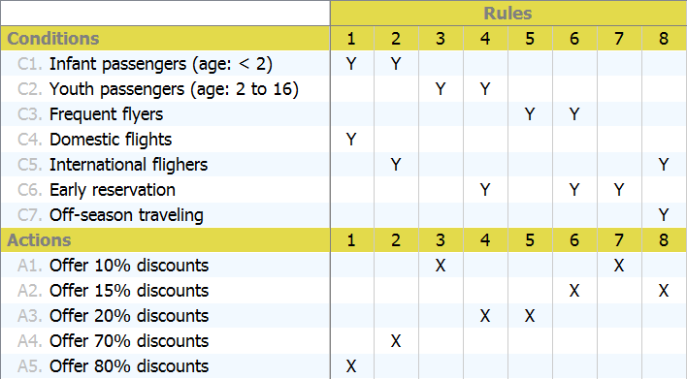
Now as a decision table…

Slide 26
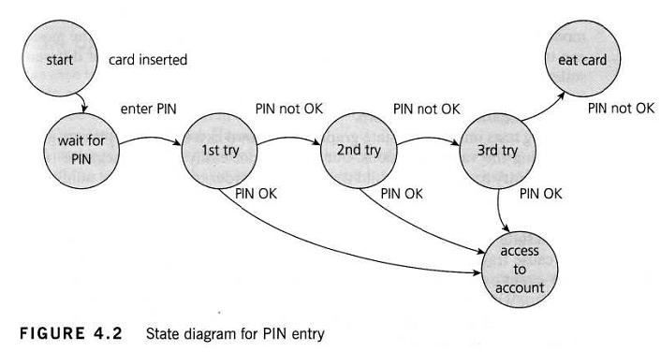
State Transition Testing
Convenient if you have a UML State Machine diagram handy…
…but seriously, you need to depict a finite state machine somehow
7 states
4 actions (transitions)

Slide 27
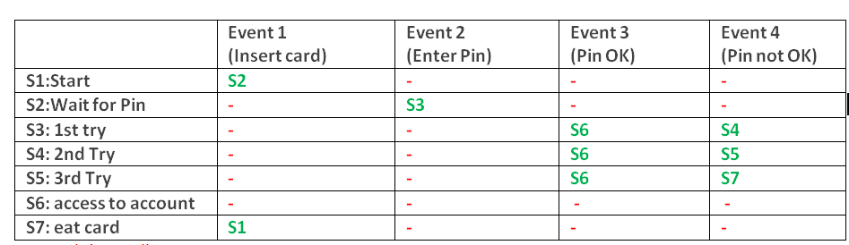
Transition table
Also need to test for invalid transitions
Sometimes difficult to spot on a state-transition table
Dashes represent invalid transitions

Slide 28
Use Case Testing
Convenient if your project requirements are documented as Use Cases
Part of UML
By convention, each use case describes:
The main success scenario
Alternative scenarios (or “extensions”)

Slide 29
Customer registration Use Case
Actors
Customer
Summary
A Customer who wants to use mobile hair care services registers to the site thereby creating an account.
Pre-Conditions
User not previously registered.
Basic course of action
Customer goes to the website and requests a new account
Customer enters enough of a profile to enable scheduling (name, address, email address, payment info, phone number)
Account is created.
Customer receives notification by email, text or both about the new account.
Alternative sequences
User abandons the registration process before account is created.
User cancels registration process.
Post-conditions
The account for the Customer exists.

Slide 30
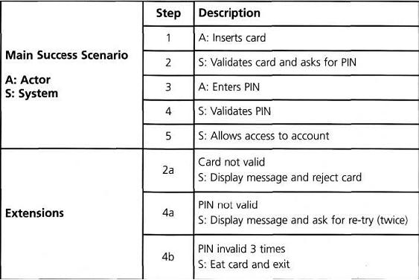
Example Use Case

Slide 31
Group Discussion: use Discussion 6 groups

